Slide 1
MY SQL PROJECT
SUBMITTED BY
SRI LAKSHMI BAHVANI

Slide 2
What Is MY SQL ?
SQL Stands for structured query language(SQL) is fundamentally a programming language designed for accessing, modifying and extracting information from relational databases
Helps you to access and manipulate databases.
An official SQL standard was adopted by the American National standards institute(ANSI) in 1986 ,with the International Organization for standardization(ISO) adopting the standard in 1987.

Slide 3

What is Database?
By definition, a database is merely a structured collection of data.
(or)
A database is an organized collection of structured information, or data, typically stored electronically in a computer system. A database is usually controlled by a database management system

Slide 4
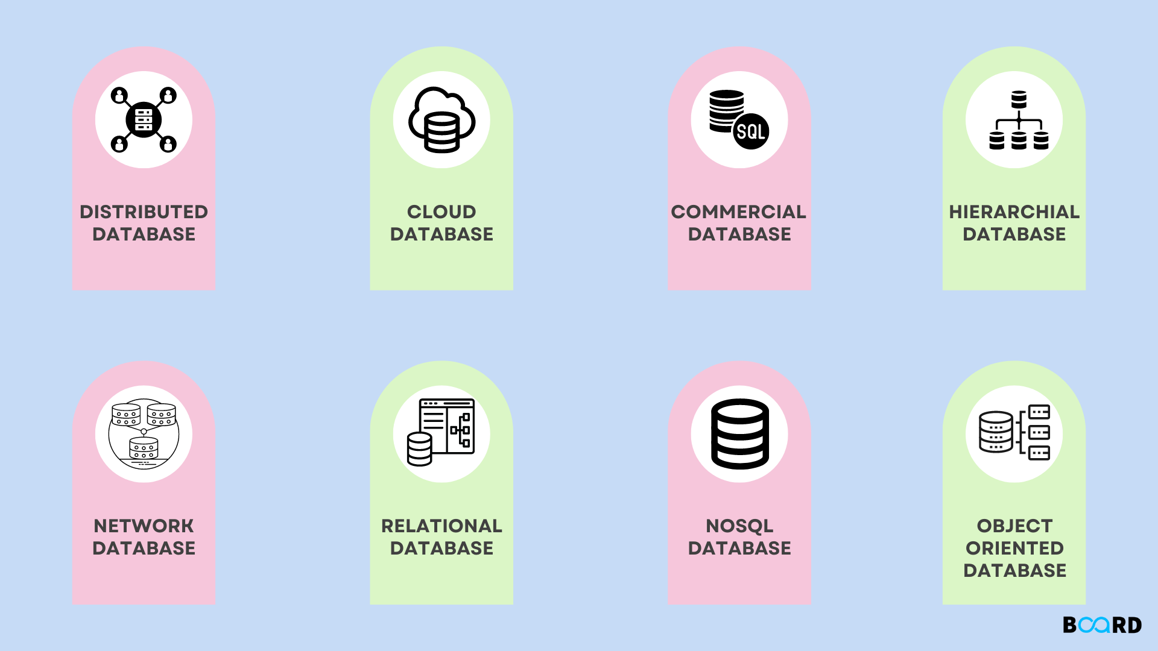
Types of Database

Slide 5
Numeric Data Type
INT :Integer data type for storing whole numbers.
BIGINT :Large integer data type for very large whole numbers.
SMALLINT :Small integer data type for small whole numbers.
DECIMAL/NUMERIC :Fixed-point numeric data type that stores exact numeric values with a specified precision and scale.
FLOAT/REAL : Floating-point numeric data type for approximate numeric values with a specified precision.

Slide 6
Date And Time
DATE :Date data type for storing dates (Year,month,day).
TIME : Time date type for storing time of day.
DATETIME/TIMESTAMP :Date and time data type for storing both date and time information.
INTERVAL : Represents a period of time.

Slide 7
Difference of DBMS AND RDBMS
DBMS
RDBMS
Database Management Systems (DBMS) are software systems
it used to store, retrieve, and run queries on data.
A DBMS serves as an interface between an end-user and a database, allowing users to create, read, update, and delete data in the database
RDBMS stands for Relational Database Management System.
RDBMS is a program used to maintain a relational database.
RDBMS is the basis for all modern database systems such as MySQL, Microsoft SQL Server, Oracle, and Microsoft Access.
RDBMS uses SQL queries to access the data in the database

Slide 8
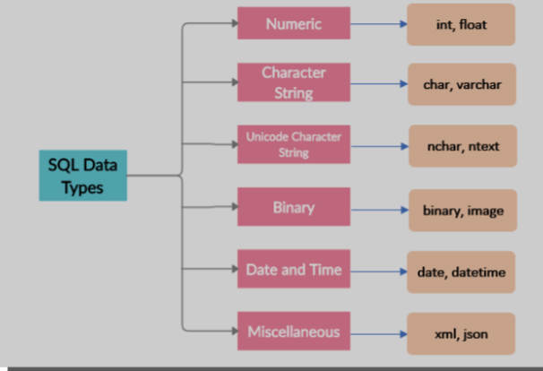
Datatypes of SQL
SQL Data type is used to define the values that a column can contain.
Every column is required to have a name and data type in the database table.

Slide 9
Join Queries
My SQL Date Functions
Logical Functions
My SQL Calculate Functions
My SQL Main Commands
SQL
concepts
My SQL String Functions
RDBMS Systems
Triggers (SQL Automation)
Procedures concepts (SQL Automation)
My SQL General Functions

Slide 10
MY SQL MAIN COMMANDS

Slide 11
CREATING DATABASE,SHOW DATABASE,USE DATABASE&DROP DATABASE
Create database :-To create database
Create database rani20;
Use rani20;
Show database :- shows all created databases
Show databases
Drop database:- to drop the database
Drop database rani20

Slide 12
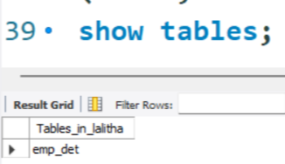
CREATING TABLE & SHOW TABLES
Create table
Show table

Slide 13
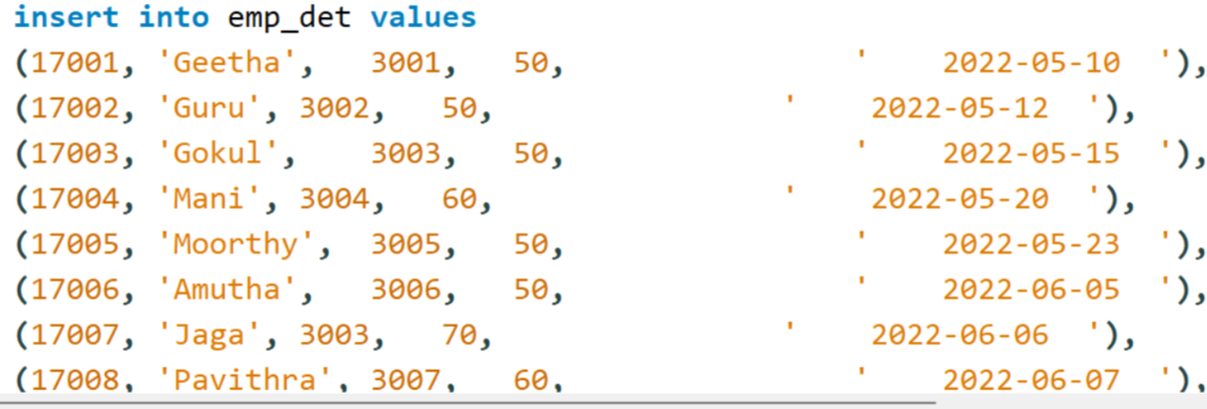
INSERT VALUES
Inserting values into table

Slide 14
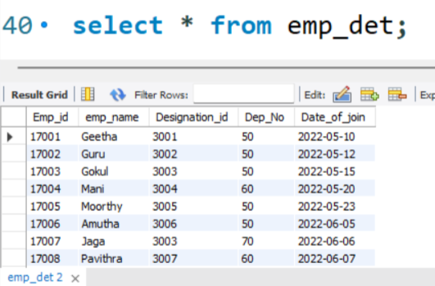
SQL SELECT STATEMENT
The SELECT statement is used to select data from a database

Slide 15
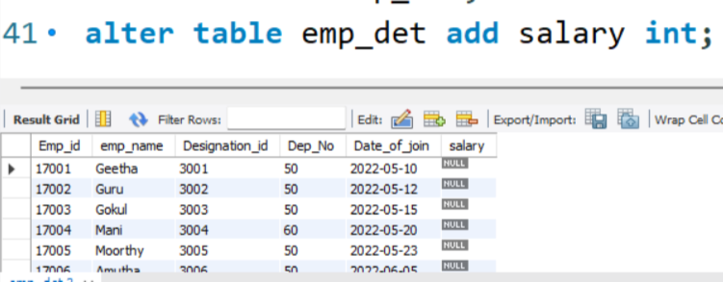
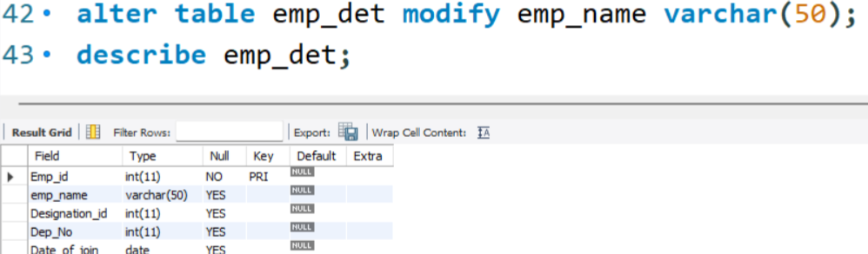
SQL ALTER TABLE STATEMENT
The ALTER TABLE statement is used to add, delete, modify, drop & rename columns in an existing table.
ADD
Modify

Slide 16
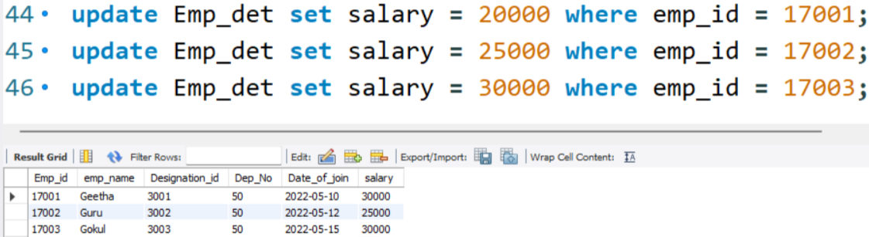
Update statement
The UPDATE statement is used to modify the existing records in a table

Slide 17
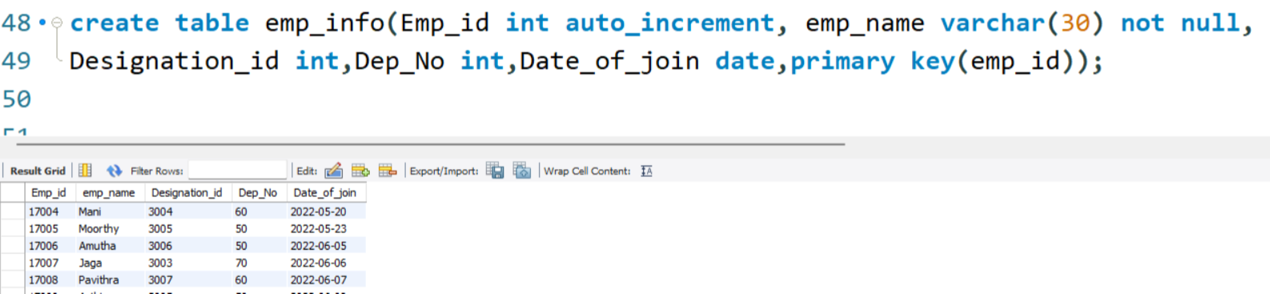
CONSTRAINTS
NOT NULL :-Ensures that A Column cannot have a null values
Auto increment:- it allows a unique number to be generated automatically when a new record is inserted into table
Default:-Sets a default value for column if no value is specified
Primary key:-Uniquely identifies each row in a table

Slide 18
GENERAL FUNCTIONS

Slide 19
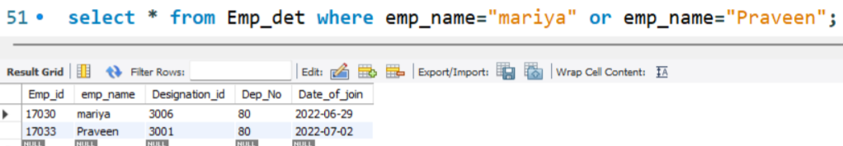
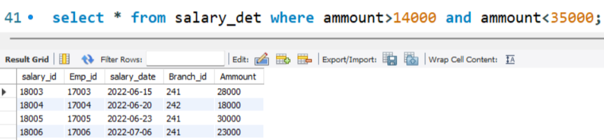
WHERE , OR , AND
Where:- The WHERE clause is used to filter record
Or:-The OR Operator displays a record if any of the condition separated by Or is true
And:- The AND Operator displays a record if allthe condition separated by AND are true

Slide 20
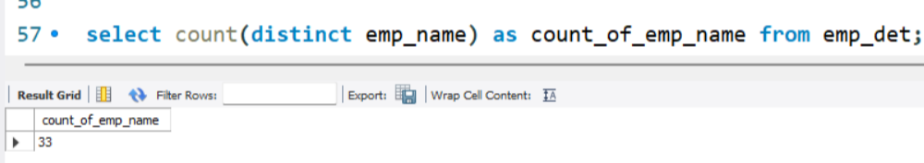
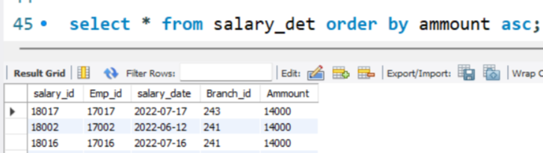
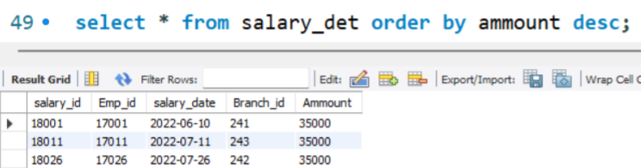
COUNT, DISTINCT ,ORDER BY
Count:-The Count() function returns the number of rows that matches a specifies criterion.
Distinct:-The select distinct statement is used to return only different values
ORDER BY:- The ORDER BY keyword id used to sort the result-set in ascending or descending order

Slide 21
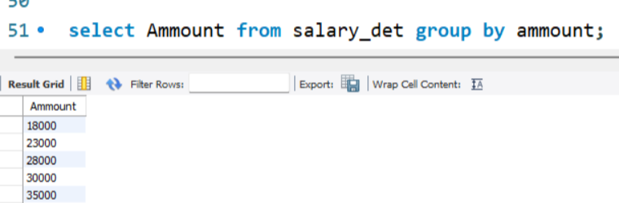
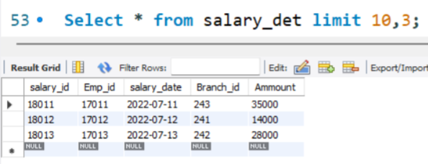
GROUP BY, LIMIT
GROUP BY:- The GROUP BY statement groups rows that have the same values into summary rows, like "find the number of customers in each country".
Limit:- The LIMIT clause is used to specify the number of records to return.

Slide 22
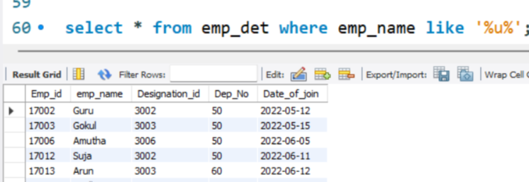
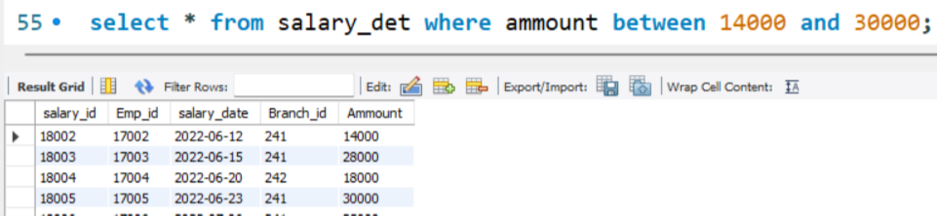
LIKE, BETWEEN
Like:-The LIKE operator is used in a WHERE clause to search for a specified pattern in a column.
Between:-The BETWEEN operator selects values within a given range. The values can be numbers, text, or dates.

Slide 23
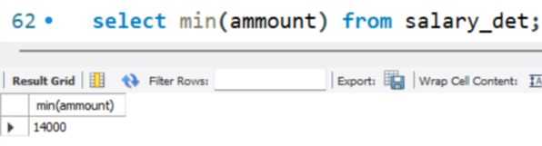
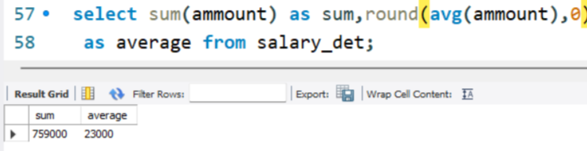
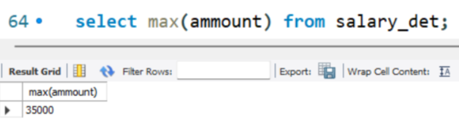
CALCULATTION FUNCTIONS
SUM AVERAGE
MINIMUM
MAXIMUM

Slide 24
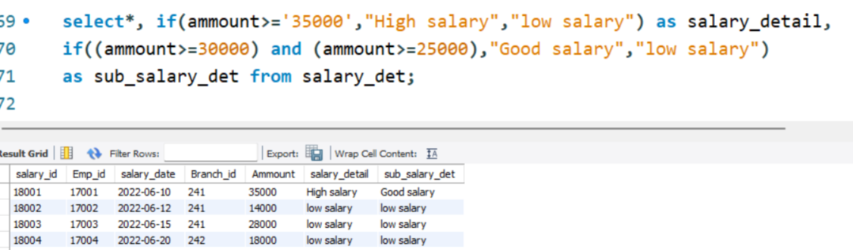
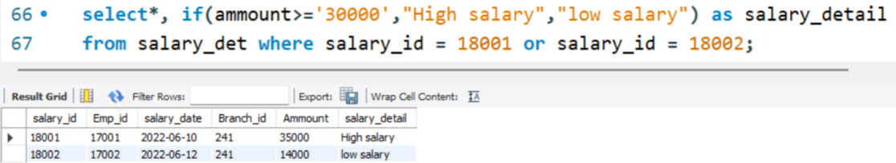
LOGICAL FUNCTIONS
If with and condition
If with or condition

Slide 25
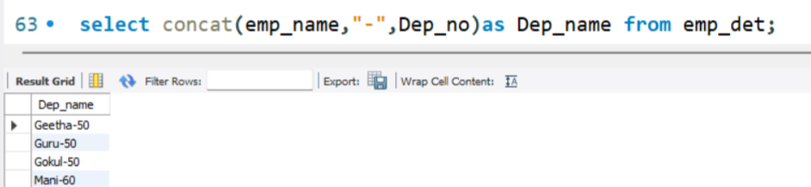
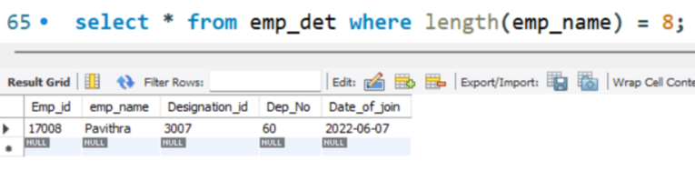
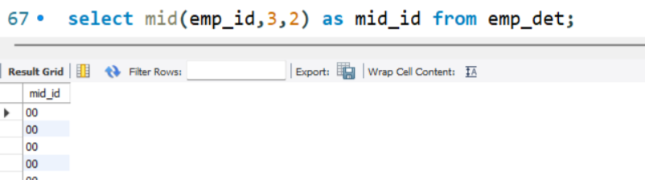
STRING FUNCTIONS
CONCAT:-Add two strings together.
Length:-Return the length of the string.
Mid :-Extract a substring from a string (start at Position 5, extract 3 characters)

Slide 26
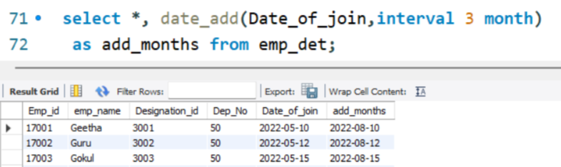
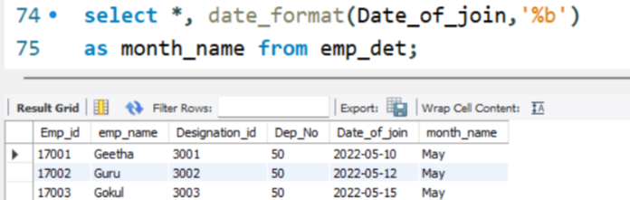
DATE FUNCTIONS
Date Add():- Add year or month or days to a date, then return the date
Date Format():-The Date Format() function formats a date as specified

Slide 27
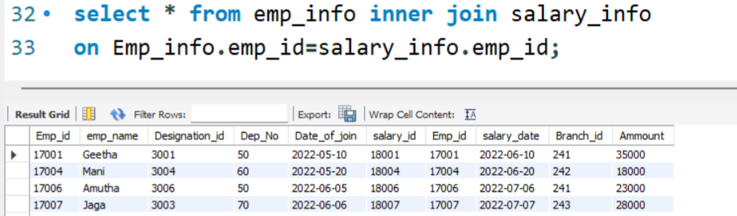
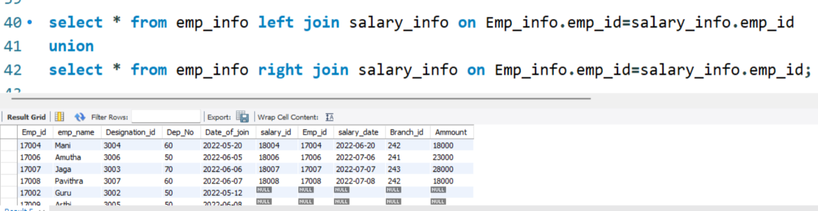
JOIN QUERIES
.
Inner join:- The Inner Join keyword selects records that have matching values in both tables
Union:- The UNION operator is used to combine the result-set of two or more SELECT statements

Slide 28
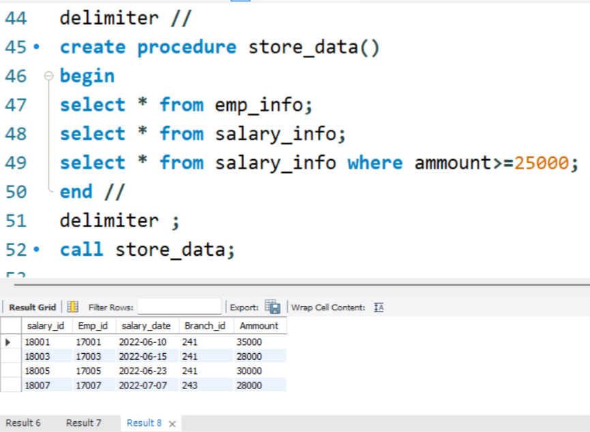
STORED PROCEDURES
Stored Procedure:- A stored procedure is a prepared SQL code that you can save, so the code can be reused over and over again.

Slide 29
TRIGGER
Trigger:- A database trigger is stored program which is automatically fired or executed when some events occur
Types of trigger:- * Row level trigger
* Statement level trigger
Trigger timings:-
Before insert
After insert
Before update
After update
Before delete
After delete

Slide 30
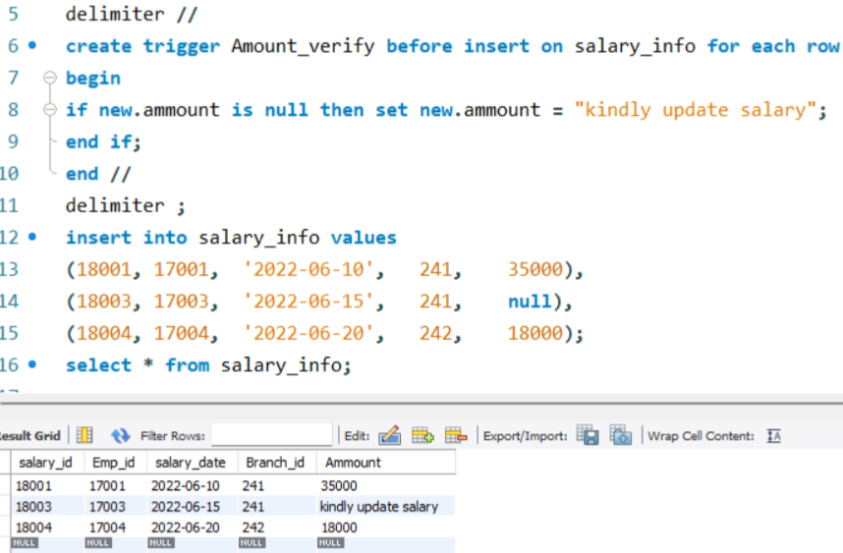
ROW LEVEL TRIGGER
An event is triggered at row level for each row updated, inserted or deleted

Slide 31
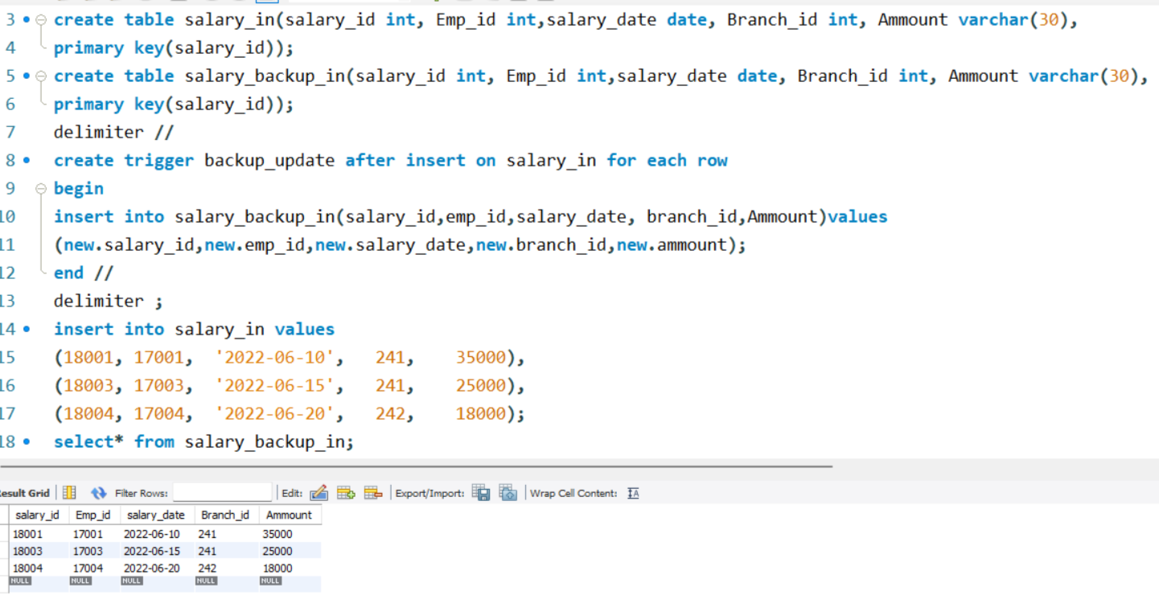
STATEMENT LEVEL TRIGGER
An event is triggered at table level for each SQL statement executed

Slide 32
THANK YOU

